Slide 1
State Diagram
State Chart Diagram
State Transition Diagram

Slide 2
Introduction
Two interaction diagrams with objects of the same class receiving the same messages may respond differently
This is because an object’s behavior is affected by the values of its attributes
UML State Machine Diagram records these dependencies

Slide 3
State Transition Diagram
A state transition diagram is a technique to depict:
The states of an entity
The transitions of states of the entity
The trigger or the event that caused the transition of state of the entity
The entity may be a physical device such as a light switch or a vending machine; it may be a software system or component such as a word processor or an operating system; it may be a biological system such as a cell or a human; or - - - -
This modeling technique came from a more formal area called automata theory.
State transition diagram depicted a Finite State Machine.

Slide 4
Software Program View
The end product of a software is a program which executes. In depicting the program (or an object) we can consider:
Variables which take on different values
Control structure and assignment statements (events) in the program that change the values of the variables
Combination of values of the data (variables & constants) at any point of the program represent the program state at that point.
2. The change made to the values of the variables through assignment statements represent a transition of state

Slide 5
A very simple example light switch
From
State
(light)
To
State
(light)
Alt
Event
(switch)
switch
light
on turnOff off
[l_st=on]
TurnOff ( )
[l_st=off]
off turnOn on
TurnOn ( )
2. “State transition table”
for light with switch events
1. “Sequence diagram” (alternative fragment) for switch and light interaction
turnOff
light
on
light
off
turnOn
3. “State transition diagram”
for light with switch events

Slide 6
A little “more” on the light switch
turnOff
turnOff
turnOff
on
off
on
off
turnOn
turnOn
turnOn
What happens if we turn on
a light that is already on?
state can “transition” to its
current state

Slide 7
Using State Transition Diagram
Model the entity at the “abstraction” level where the number of states is “manageable.”
List (design) the states (should not be large)
List events that will trigger the state transition (should not be big)
There must be a starting state
There must be a terminating state or states
Design the transition rules (the bulk of your design work is thinking through the transition rules)
1.The above is not necessarily performed in sequence; iterate through these.
2. Even with a modest number of states and events, the state transition
diagram, which really depicts the transition rules, can be enormous.

Slide 8
State Diagrams
State diagrams are used to show possible states a single object can get into
shows states of an object
How object changes state in response to events
shows transitions between states

Slide 9
Elements of State Diagram
Start marker
Stop marker
States – box with rounded corners
Transitions – shown as arrows between states
Events – that cause transition between states
Action – an object’s reaction to an event
Guard

Slide 10
Naming Conventions for a state
Each unique state has a unique name
State Names are verb phrases
A noun to name a state – incorrect

Slide 11
State Diagrams: States
States are represented as rounded boxes which contain:
the state name
and the following optional fields
entry and exit actions: entry and exit actions are executed whenever the state is entered or exited, respectively
Internal transitions: A response to an event that causes the execution of an action but does not cause a change of state or execution of exit or entry actions.
External transition: A response to an event that causes a change of state or a self-transition, together with a specified action.
Activities: Typically, once the system enters a state it sits idle until an event triggers a transition. Activities help you to model situations where while in a state, the object does some work that will continue until it is interrupted by an event

Slide 12
State Diagrams: States
Tracking
entry action
entry / setMode(on Track)
exit / setMode(off Track)
Tracking / tracker.Acquire()
newTarget/tracker.ChangeTrack()
do / followTarget
exit action
internal transition
external transition
activity
Note that, “entry”, “exit”, “do” are keywords

Slide 13
State Diagrams: Transitions
Transitions
source state and target state: shown by the arrow representing the transition
trigger event: the event that makes the transition fire
guard condition: a Boolean expression that is evaluated when the trigger event occurs, the transition can fire only if the guard condition evaluates to true
action: an executable atomic computation that can directly act on the object that owns the state machine or indirectly on other objects that are visible to the object
initial and final states: shown as filled black circle and a filled black circle surrounded by an unfilled circle, respectively
source state
target state
trigger-event[guard-condition]/action

Slide 14
State Diagrams
shows the initial (default) state
getFirstItem
getNextItem
[not all items checked]
Checking
do / checkItem
cancelled
shows the final state

Slide 15
State Diagram Example: States of an Order object
getFirstItem
getNextItem
[not all items checked]
Checking
[all items checked and
all items available]
Dispatching
do/checkItem
do/initiate
Delivery
ItemReceived
and all items available
[all items checked and
some items not in stock]
cancelled
itemsReceived
[some items not in stock]
Waiting
cancelled
Delivered
cancelled
Cancelled

Slide 16
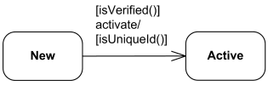
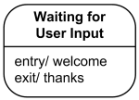
Types of State Machine Diagram
Protocol State Machines: These are used to express a usage protocol or a lifecycle of some classifier. It shows which operations of the classifier may be called in each state of the classifier, under which specific conditions, and satisfying some optional postconditions after the classifier transitions to a target state.
Behavioral State Machines: These are specialization of behavior and is used to specify discrete behavior of a part of designed system through finite state transitions.

Slide 17
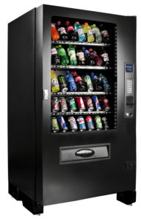
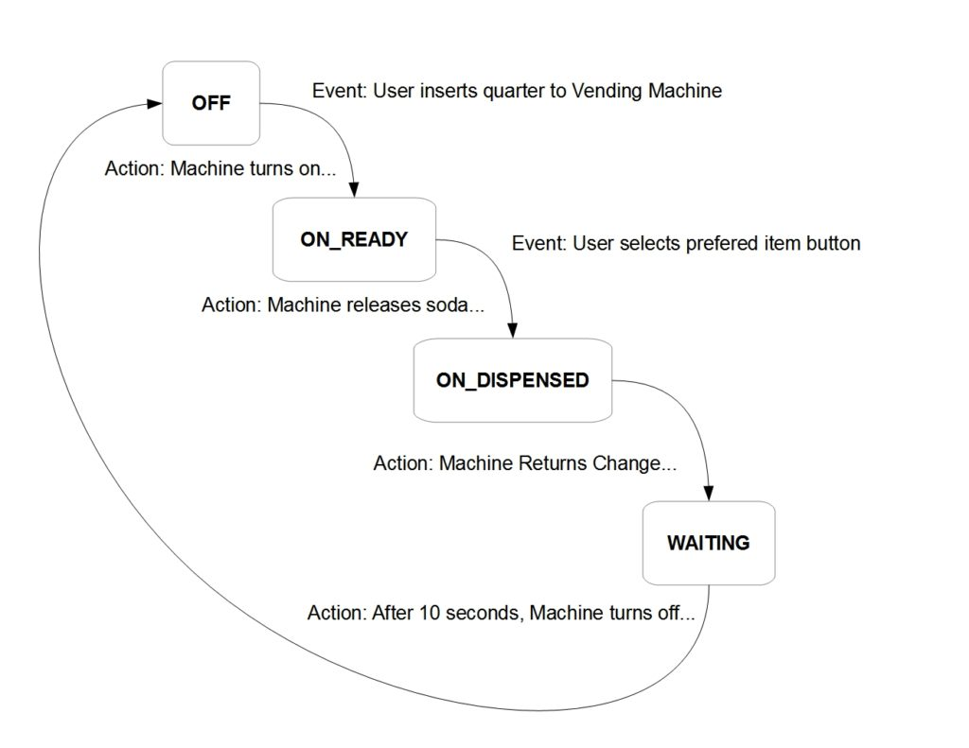
Example of Protocol State Machines
Soda Vending Machine

Slide 18
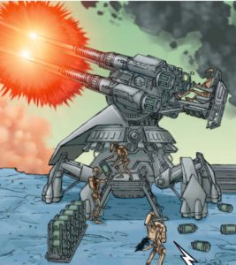
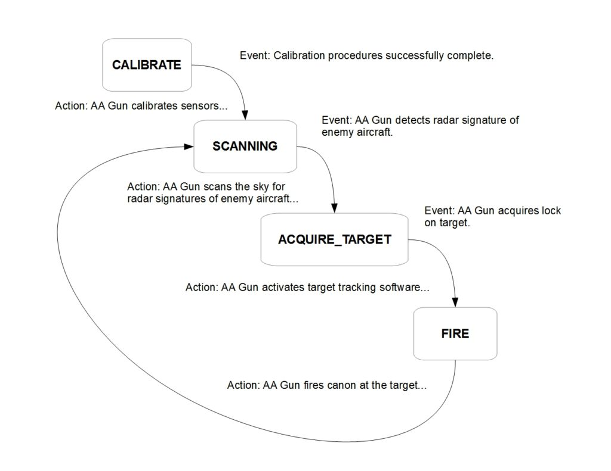
Example of Behavioral State Machines
Anti-Aircraft (AA) Gun

Slide 19
Advanced State Machine Modeling
Nested states
Concurrent states

Slide 20
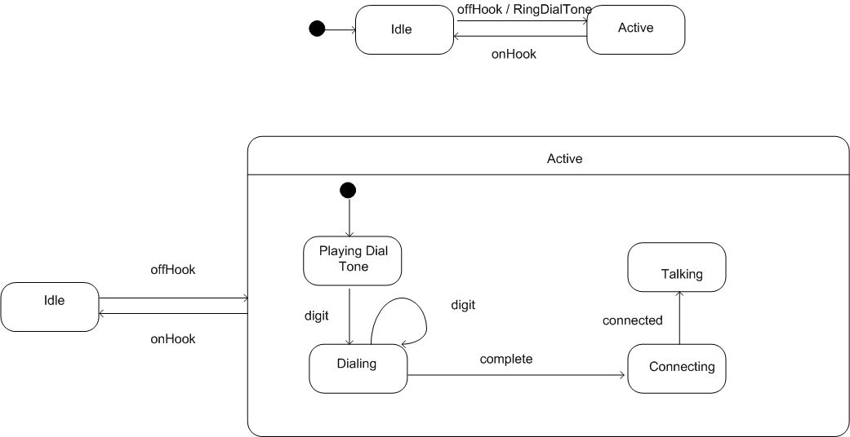
Nested State Machine- Telephone

Slide 21
Nested State Machine- Printer
Example: When the printer is in On state, it may also be in Idle or Working
To show these two states, draw lower level state diagrams within On state
When the printer is on, it begins at Idle state, so printer is in both On and Idle state
When print message is received, it moves to working state and also remains in On state

Slide 22
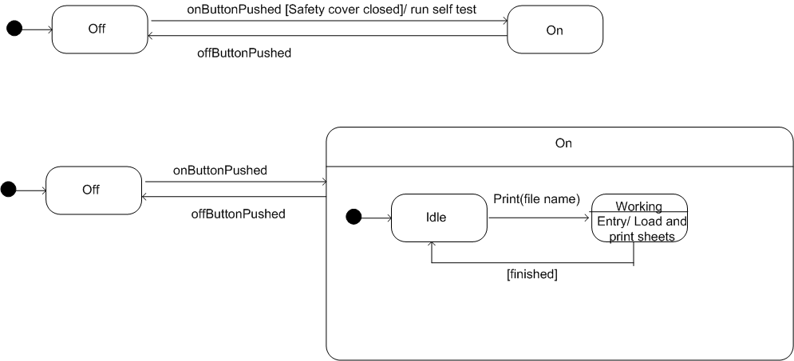
Nested State Machine- Printer

Slide 23
Concurrent states
A Printer object cycles between two separate paths. The two independent paths are;
Representing states of the work cycle.
Representing states of the input paper tray

Slide 24
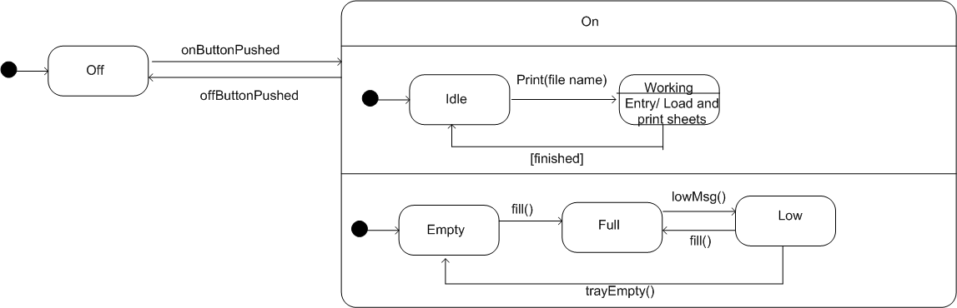
Concurrent State Machine- Printer

Slide 25
State Diagrams Importants
Use them to show the behavior of a single object not many objects
for many objects use interaction diagrams
Do not try to draw state diagrams for every class in the system, use them to show interesting behavior and increase understanding

Slide 26
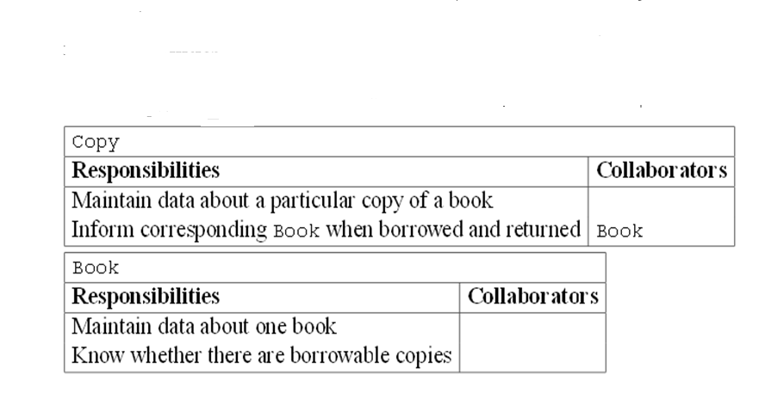
CRC for Copy & Book

Slide 27
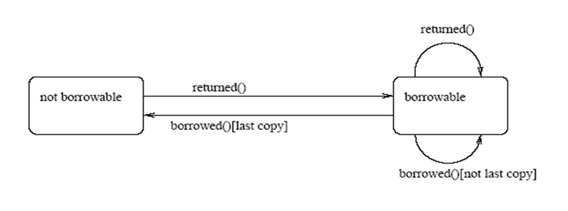
State Machine Diagram for class Book
.

Slide 28
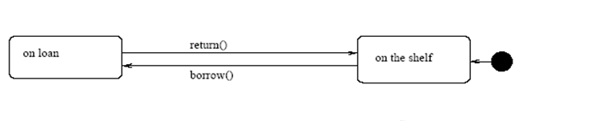
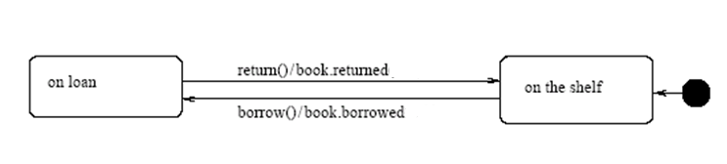
State Machine Diagram for class Copy
State Machine Diagram for class Copy with actions

Slide 29
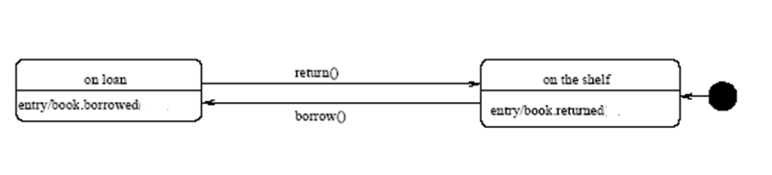
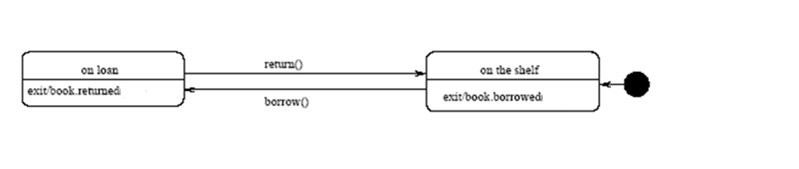
State Machine Diagram for class Copy with entry actions
State Machine Diagram for class Copy with exit actions

Slide 30
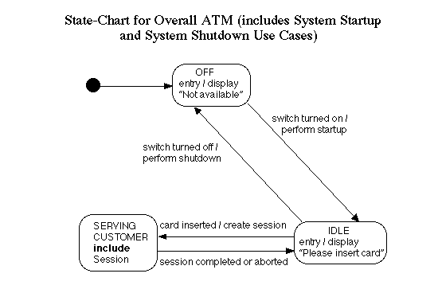

Slide 31
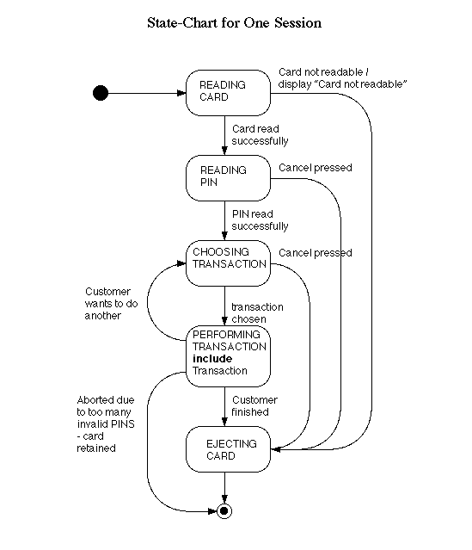

Slide 32
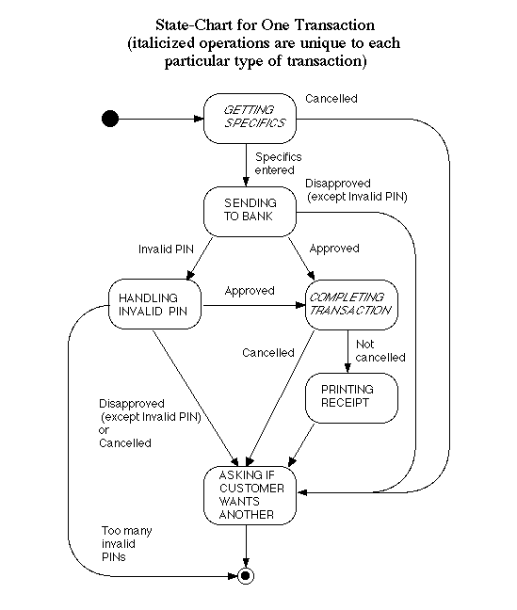

Slide 33
Librarians categorize the library books into loanable and non-loanable books. The non-loanable books are the reference books. However, the loanable books are the non-reference books. After cataloguing the books, the books are available for loan. Students who borrow the library books should return them back before the due date. Books that are 12 months over the due date would be considered as a lost state. However, if those books are found in the future, they must be returned back to the library. When the books are found not required in the library or have been damaged, the book would be disposed.

Slide 34
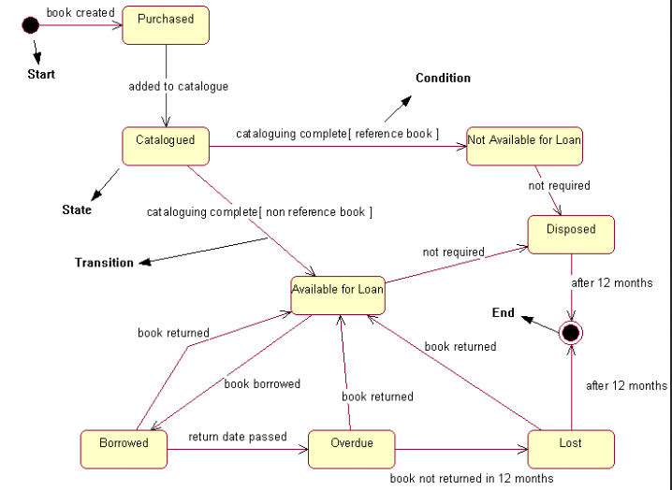

Slide 35
Difference between Activity and State Chart Diagram
State diagram shows the object undergoing a process. It gives a clear picture of the changes in the object's state in this process. e.g: ATM withdraw Card object state: Checking, Approving, Rejecting Activity diagram is a fancy flow chart which shows the flow of activity of a process. e.g: ATM withdraw Withdraw activity: Insert Card, Enter PIN, Check balance, with draw money, get card
State chart shows the dynamic behavior of an object. Activity diagram shows the workflow behavior of an operation as set of actions

Slide 36
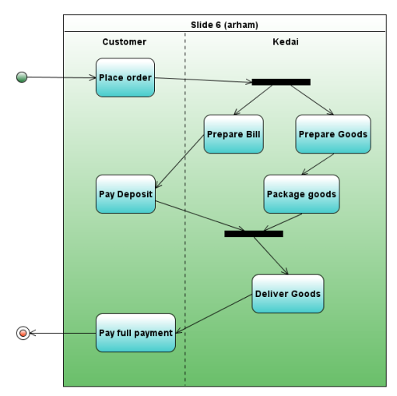

Slide 37
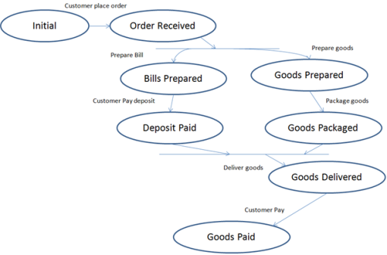

Slide 38
Online Shopping System

Slide 39
Music Player System

Slide 40
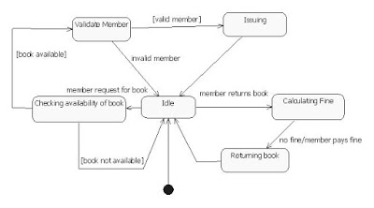
Library Management System

Slide 41
Problem # 1
A simple digital watch has a display and two buttons to set it, the A button and the B button. The watch has two modes of operation, display time and set time.
In the display time mode, the watch displays hours and minutes, separated by a flashing colon.
The set time mode has two submodes, set hours and set minutes. The A button selects modes. Each time it is pressed, the mode advances in the sequence: display, set hours, set minutes, display, etc.
Within the submodes, the B button advances the hours or minutes once each time it is pressed. Buttons must be released before they can generate another event.
Prepare a state diagram of the watch.

Slide 42
Solution of Problem # 1
DigitalWatch
A
Set hours
do / show hours
A
A
Display time
do / show hours and minutes
B / advance hour
Set minutes
do / show minutes
B / advance minute

Slide 43
Problem # 2
A separate appliance control determines when the motor should be on and continuously asserts on as an input to the motor control when the motor should be running.
When on is asserted, the motor control should start and run the motor.
The motor starts by applying power to both the start and the run windings. A sensor, called a starting relay, determines when the motor has started, at which point the start winding is turned off, leaving only the run winding powered. Both winding are shut off when on is not asserted.
Appliance motors could be damaged by overheating if they are overloaded or fail to start. To protect against thermal damage, the motor control often includes an over-temperature sensor. If the motor becomes too hot, the motor control removes power from both windings and ignores any on assertion until a reset button is pressed and the motor has cooled off.
Add the following to the diagram.
Activities: apply power to run winding, apply power to start winding.
Events: motor is overheated, on is asserted, on is no longer asserted, motor is running, reset.
Condition: motor is not overheated.

Slide 44
MotorControl
Off
Starting
Running
Too hot

